Slide 1



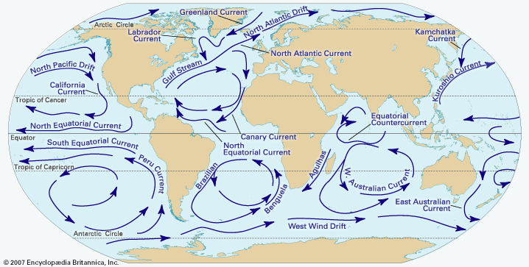
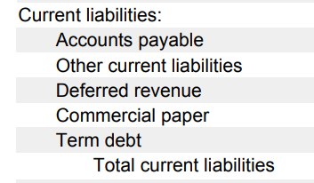
Current Liabilities and Contingencies - Video

Slide 2
What is a liability?
Definition:
Probable future sacrifice of resources arising from a current obligation to transfer assets/services as a result of a past event.
Recognize if there is a:
Firm currently has an obligation
The obligation resulted from a past transaction or event
The obligation requires the outlay of a probable future resource
The amount is quantifiable/measurable (“estimable”)
Notes:
Re. (4), we will talk about contingent obligations next week

Slide 3
Liability Classification by Timing
Liabilities are separated into current and noncurrent based on when the obligation must be fulfilled.
Current liabilities: obligations due within the current operating cycle (generally one year).
Classify as noncurrent if intend and able to refinance
Non-current liabilities: obligations that do not need to be fulfilled within the current operating cycle.
Important Note
One liability could be split into current and non-current!
Obligations with periodic payments (e.g., a mortgage) may be noncurrent but have a current portion.
Notes:
Separate based on either
When the obligation must be filled or
The type of asset used to fulfill the obligation

Slide 4
Current liabilities
We cover:
Accounts payable
Sales tax payable
Gift cards
Warranties
Other current liabilities (not exhaustive):
Wages
Payroll taxes
Current portion of long-term debt
Dividends payable
Salaries payable
Unearned revenue

Slide 5
Current liabilities
We cover:
Accounts payable
Sales tax payable
Gift cards
Warranties
Other current liabilities (not exhaustive):
Wages
Payroll taxes
Current portion of long-term debt
Dividends payable
Salaries payable
Unearned revenue

Slide 6
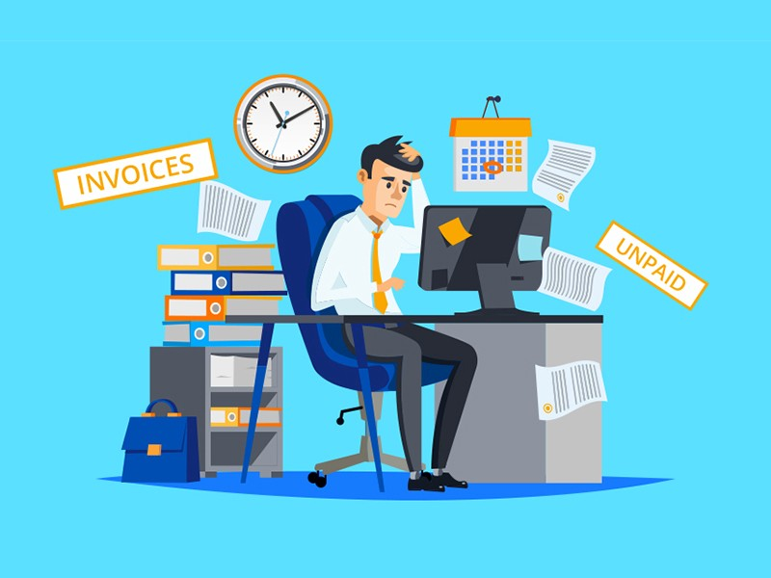
Accounts payable
Accounts payable are promises by the company (purchaser) to pay for goods or services.
Usually open line of credit with no interest.
Initial measurement of payable may be affected by purchase discounts (think 2/10, n/30).
Mirror image of accounts receivable

Slide 7
Operating cycle of Amazon.com
Inventory ↑ A/P ↑
Inventory ↓ Cash ↑
Cash ↓ A/P ↓
Last 3 months of the year: Amazon buys inventory to prep for holidays
End of the year (Dec 31st):
Customers purchases goods
First 3 months of next year:
Amazon pays back suppliers

Slide 8
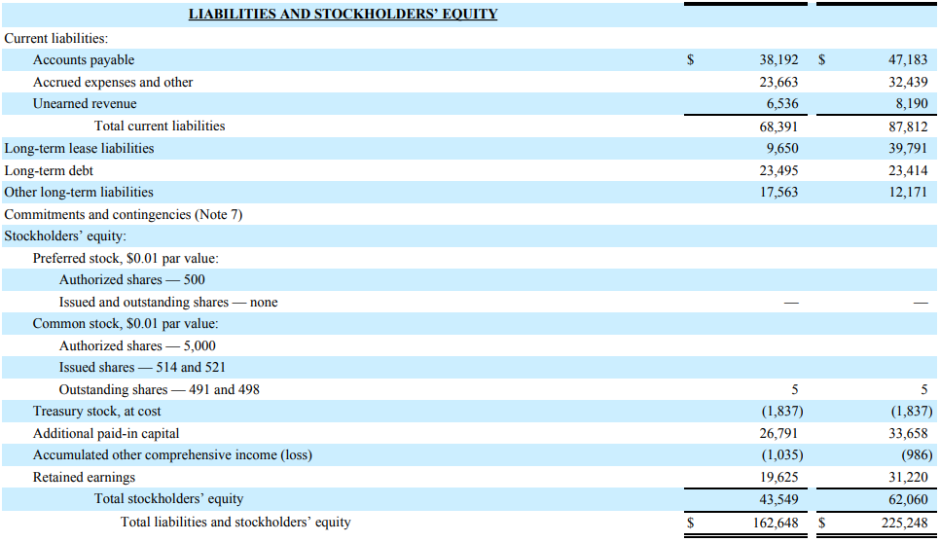
Amazon.com (2014)
Notes:
Numbers are in MILLIONS. A/P makes up nearly 60% of current liabilities, nearly 40% of all liabilities.

Slide 9
A/P Discounts
Mack Attack Inc. buys $20,000 of inventory with 2/10, net/30 terms.
Gross Method
At purchase: Inventory (B-A) 20,000
A/P (B-L) 20,000
Pay early: A/P (B-L) 20,000
Cash (B-A) 19,600
Inventory (B-A) 400
Pay late: A/P (B-L) 20,000
Cash 20,000

Slide 10
A/P Discounts
Mack Attack Inc. buys $20,000 of inventory with 2/10, net/30 terms.
Net Method
At purchase: Inventory (B-A) 19,600
A/P (B-L) 19,600
Pay early: A/P (B-L) 19,600
Cash (B-A) 19,600
Pay late: A/P (B-L) 19,600
Inventory (B-A) 400
Cash 20,000

Slide 11
Current liabilities
We cover:
Accounts payable
Sales tax payable
Gift cards
Warranties
Other current liabilities (not exhaustive):
Wages
Payroll taxes
Current portion of long-term debt
Dividends payable
Salaries payable
Unearned revenue

Slide 12
Sales Taxes Payable
Company is obligated to collect sales tax on behalf of the state. Remits the sales tax collected periodically.
Parrot Shoes Inc. sells a pair of sandals for $100 and the state sales tax is 7%.
Upon Sale: Cash (B-A) 107
Revenue (I-R) 100
Sales Tax Payable (B-L) 7
Upon Remittance: Sales Tax Payable (B-L) 7
Cash (B-A) 7

Slide 13
Closing Thoughts
Current liabilities are obligations to pay within a year.
Accounts payable are open, informal liabilities usually related to the purchase of inventory from a supplier.
Sales taxes are collected from the customer by the seller of goods and later remitted to the state.

Slide 14
Current Liabilities and Contingencies - Video

